Slide 1
Car Price Prediction Project

Slide 2
Problem Statement And Understanding
With the covid 19 impact in the market, we have seen lot of changes in the car market. Now some cars are in demand hence making them costly and some are not in demand hence cheaper. One of our clients works with small traders, who sell used cars.
With the change in market due to covid 19 impact, our client is facing problems with their previous car price valuation machine learning models. So, they are looking for new machine learning models from new data. We have to make carprice valuation model..

Slide 3
Exploratory Data Analysis
This is a Regression problem. The target variable contains numeric float values.
Null Values: There are Null values in the dataset.
The dataset has Categorical features also.

Slide 4
Data Preprocessing
Data Preprocessing Approach:
Imputed missing values.
Cleaned the data to remove unwanted symbols like currency symbols.
Derived the age of the car from manufactured_year.
Converted the price to show in the same range.
Removed ‘km’/’kms’ from kilometers_driven.
Used 1,2,3 and 4 in owners feature. 4 represents 4 or 4+ owners.
Corrected data in fuel_type to be grouped under the main categories.

Slide 5
Data Encoding
The Get dummies method in Pandas was used to encode the categorical data.
The cardinality of the dataset is very high.

Slide 6
Visualizations

Slide 7
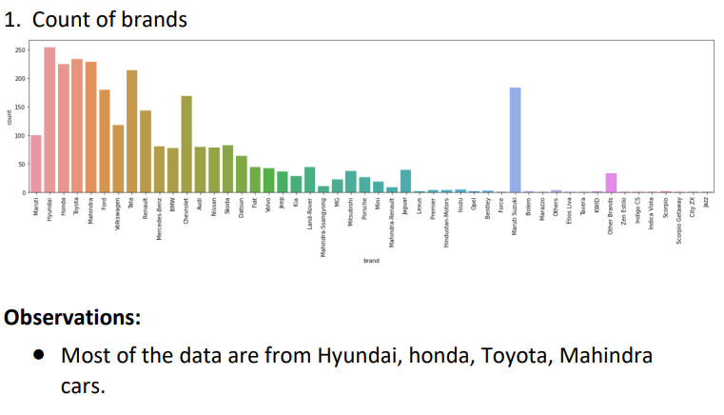

Slide 8
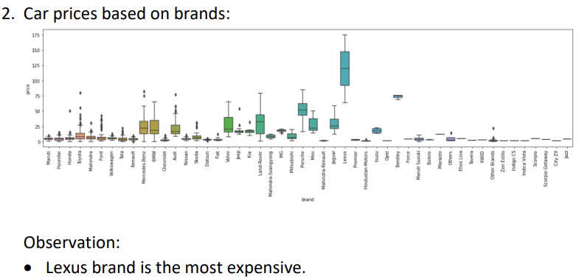

Slide 9
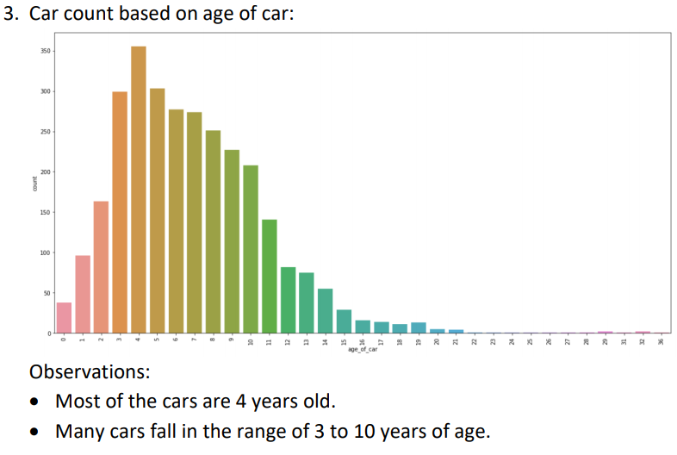

Slide 10
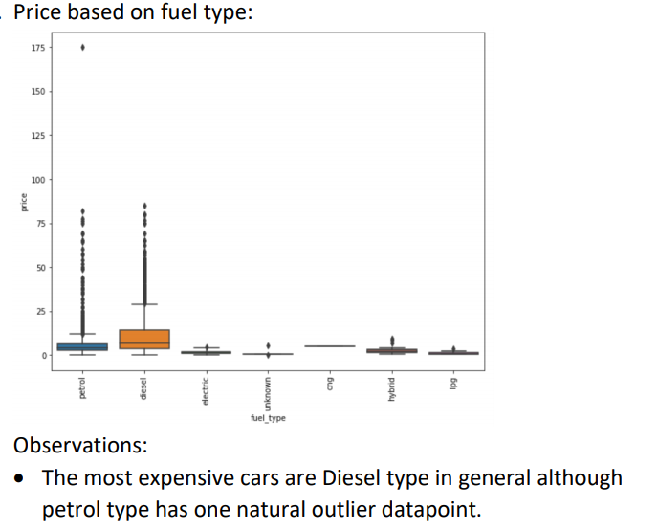

Slide 11
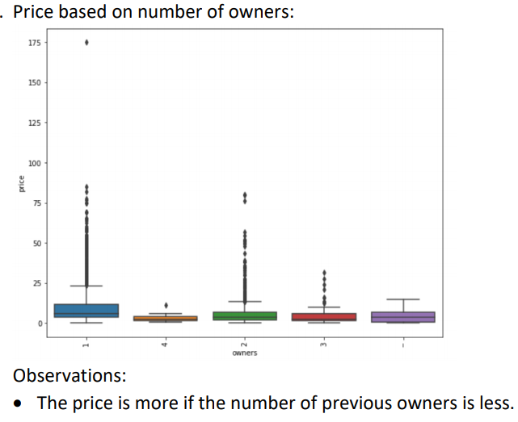

Slide 12
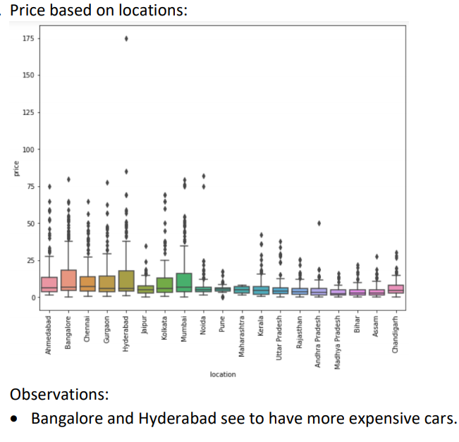

Slide 13
Steps taken to complete the Project
Scraped data from OLX and Cardekho sites.
Performed data preprocessing as required.
Encoded the categorical features.
Trained and validated different Machine Learning classification models(base and ensemble models) to select a suitable model.
Chose the final model based on R2 score, MSE and RMSE.

Slide 14
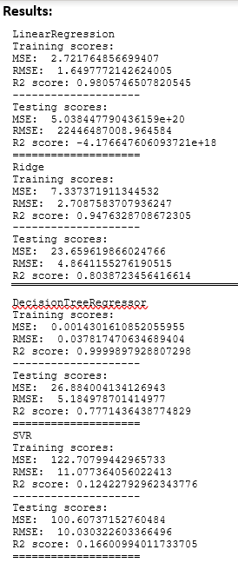
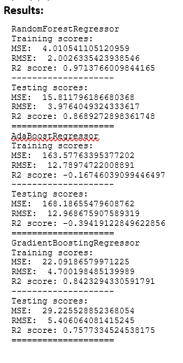
Model score comparison
Simple Models(left) and Ensemble models(right)

Slide 15
Finalized Model
The final model used is Ridge
The tuned hyper parameters used are:
alpha = 0.81

Slide 16
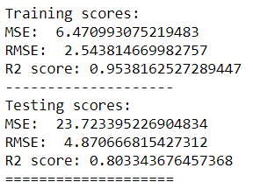
Final Model score

Slide 17
Conclusion
The Ridge is giving a better result than the other algorithms.
The performance shows low bias and low variance.

